Slide 1
Unit 04 Infrastructure as a Service (IaaS)

Slide 2
Introduction to virtualization
Virtualization has revolutionized data center’s technology through a set of techniques and tools that facilitate the providing and management of the dynamic data center’s infrastructure.
It has become an essential and enabling technology of cloud computing environments.
Virtualization can be defined as the abstraction of the four computing resources (storage, processing power, memory, and network or I/O).
It is conceptually similar to emulation, where a system pretends to be another system, whereas virtualization is a system pretending to be two or more of the same system.

Slide 3
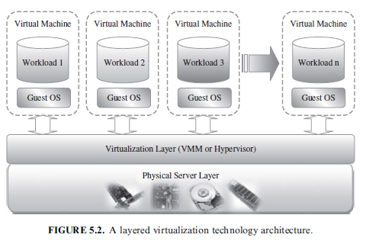
Introduction to virtualization

Slide 4
Introduction to virtualization
Virtual machine’s technology makes it very flexible and easy to manage resources in cloud computing environments, because they improve the utilization of such resources by multiplexing many virtual machines on one physical host (server consolidation).
These machines can be scaled up and down on demand with a high level of resources’ abstraction.
Virtualization enables high, reliable, and agile deployment mechanisms and management of services, providing on-demand cloning and live migration services which improve reliability.
Accordingly, having an effective management’s suite for managing virtual machines’ infrastructure is critical for any cloud computing infrastructure as a service (IaaS) vendor.

Slide 5
Introduction to virtualization
Public Cloud and Infrastructure Services
Public cloud or external cloud describes cloud computing in a traditional mainstream sense, whereby resources are dynamically provisioned via publicly accessible Web applications/Web services (SOAP or RESTful interfaces) from an off-site third-party provider, who shares resources and bills on a fine-grained utility computing basis, the user pays only for the capacity of the provisioned resources at a particular time.

Slide 6
Introduction to virtualization
Public Cloud and Infrastructure Services
There are many examples for vendors who publicly provide infrastructure as a service.
Amazon Elastic Compute Cloud (EC2)is the best known example
GoGrid
Joyent Accelerator
Rackspace
AppNexus
FlexiScale
Manjrasoft Aneka

Slide 7
Introduction to virtualization
Private Cloud and Infrastructure Services
A private cloud aims at providing public cloud functionality, but on private resources, while maintaining control over an organization’s data and resources to meet security and governance’s requirements in an organization.
Private cloud exhibits a highly virtualized cloud data center located inside your organization’s firewall.
It may also be a private space dedicated for your company within a cloud vendor’s data center designed to handle the organization’s workloads.

Slide 8
Introduction to virtualization
Private Cloud and Infrastructure Services
Private clouds exhibit the following characteristics:
Allow service provisioning and compute capability for an organization’s users in a self-service manner.
Automate and provide well-managed virtualized environments.
Optimize computing resources, and servers’ utilization.
Support specific workloads.

Slide 9
Introduction to virtualization
Private Cloud and Infrastructure Services
There are many examples for vendors and frameworks that provide infrastructure as a service in private setups.
The best-known examples are Eucalyptus
OpenNebula

Slide 10
VIRTUAL MACHINES PROVISIONING AND MANAGEABILITY
The cycle starts by a request delivered to the IT department, stating the requirement for creating a new server for a particular service.
This request is being processed by the IT administration to start seeing the servers’ resource pool, matching these resources with the requirements, and starting the provision of the needed virtual machine.
Once it is provisioned and started, it is ready to provide the required service according to an SLA, or a time period after which the virtual is being released; and free resources.

Slide 11
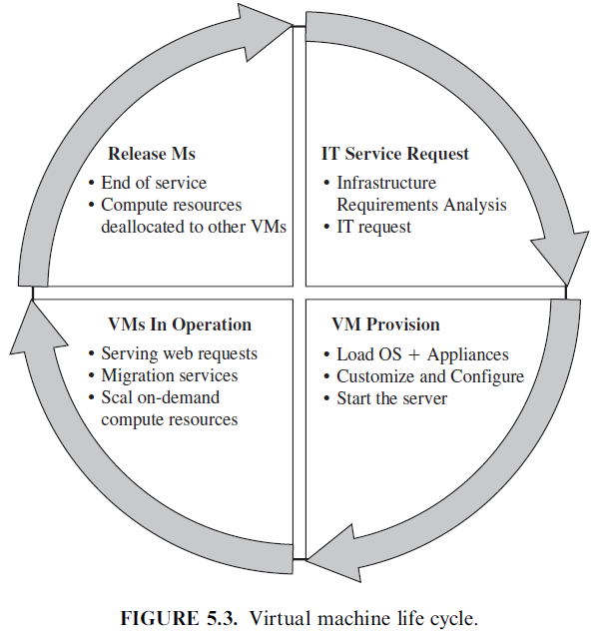
VIRTUAL MACHINES PROVISIONING AND MANAGEABILITY

Slide 12
VM Provisioning Process
Steps to Provision VM: Here, we describe the common and normal steps of provisioning a virtual server:
Firstly, you need to select a server from a pool of available servers (physical servers with enough capacity) along with the appropriate OS template you need to provision the virtual machine.
Secondly, you need to load the appropriate software (operating system you selected in the previous step, device drivers, middleware, and the needed applications for the service required).
Thirdly, you need to customize and configure the machine (e.g., IP address, Gateway) to configure an associated network and storage resources.
Finally, the virtual server is ready to start with its newly loaded software.

Slide 13
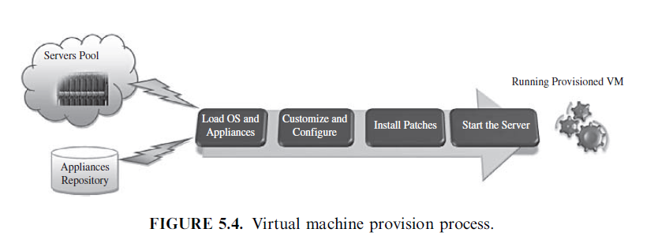
VM Provisioning Process

Slide 14
VIRTUAL MACHINE MIGRATION SERVICES
Migration service, in the context of virtual machines, is the process of moving a virtual machine from one host server or storage location to another.
There are different techniques of VM migration:
hot/life migration
cold/regular migration
live storage migration
In this process, all key machines’ components, such as CPU, storage disks, networking, and memory, are completely virtualized, thereby facilitating the entire state of a virtual machine to be captured by a set of easily moved data files.

Slide 15
Migrations Techniques
Live Migration Anatomy, Xen Hypervisor Algorithm:
Stage 0: Pre-Migration. An active virtual machine exists on the physical host A.
Stage 1: Reservation. A request is issued to migrate an OS from host A to host B (a precondition is that the necessary resources exist on B and on a VM container of that size).
Stage 2: Iterative Pre-Copy. During the first iteration, all pages are transferred from A to B. Subsequent iterations copy only those pages dirtied during the previous transfer phase.
Stage 3: Stop-and-Copy. Running OS instance at A is suspended, and its network traffic is redirected to B. As described in reference 21, CPU state and any remaining inconsistent memory pages are then transferred. At the end of this stage, there is a consistent suspended copy of the VM at both A and B. The copy at A is considered primary and is resumed in case of failure.
Stage 4: Commitment. Host B indicates to A that it has successfully received a consistent OS image. Host A acknowledges this message as a commitment of the migration transaction. Host A may now discard the original VM, and host B becomes the primary host.
Stage 5: Activation. The migrated VM on B is now activated. Post-migration code runs to reattach the device’s drivers to the new machine and advertise moved IP addresses.ost A.

Slide 16
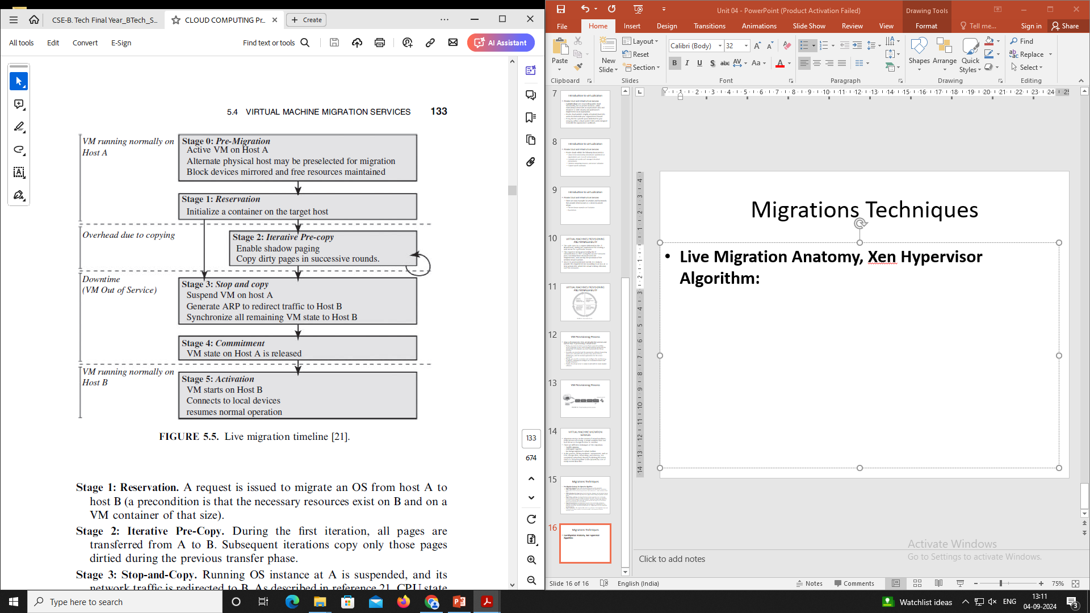
Migrations Techniques
Live Migration Anatomy, Xen Hypervisor Algorithm:

Slide 17
Migrations Techniques
Live Migration Effect on a Running Web Server:
A highly loaded server can be migrated with both controlled impact on live services and a short downtime.

Slide 18
Migrations Techniques
Live Migration Vendor Implementations Examples:
VMware Vmotion:
This allows users to automatically optimize and allocate an entire pool of resources for maximum hardware utilization, flexibility, and availability
perform hardware’s maintenance without scheduled downtime along with migrating virtual machines away from failing or underperforming servers.
Citrix XenServer XenMotion:
This is a nice feature of the Citrix XenServer product, inherited from the Xen live migrate utility, which provides the IT administrator with the facility to move a running VM from one XenServer to another in the same pool without interrupting the service making it a highly available service.
This also can be a good feature to balance the workloads on the virtualized environment.

Slide 19
Migrations Techniques
Regular/Cold Migration:
Cold migration is the migration of a powered-off virtual machine.
With cold migration, you have the option of moving the associated disks from one data store to another.
The virtual machines are not required to be on a shared storage.

Slide 20
Migrations Techniques
Regular/Cold Migration:
It’s important to highlight that the two main differences between live migration and cold migration are that live migration needs a shared storage for virtual machines in the server’s pool, but cold migration does not.
also, in live migration for a virtual machine between two hosts, there would be certain CPU compatibility checks to be applied; while in cold migration this checks do not apply.
The cold migration process is simple to implement (as the case for the VMware product), and it can be summarized as follows:
The configuration files, including the NVRAM file (BIOS settings), log files, as well as the disks of the virtual machine, are moved from the source host to the destination host’s associated storage area.
The virtual machine is registered with the new host.
After the migration is completed, the old version of the virtual machine is deleted from the source host.

Slide 21
Migrations Techniques
Live Storage Migration of Virtual Machine:
This kind of migration constitutes moving the virtual disks or configuration file of a running virtual machine to a new data store without any interruption in the availability of the virtual machine’s service.

Slide 22
VM Model and Life Cycle
The primary target of OpenNebula is to manage VMs. Within OpenNebula, a VM is modeled as having the following attributes:
A capacity in terms of memory and CPU.
A set of NICs attached to one or more virtual networks.
A set of disk images. In general it might be necessary to transfer some of these image files to/from the physical machine the VM will be running in.
A state file (optional) or recovery file that contains the memory image of a running VM plus some hypervisor-specific information.

Slide 23
VM Model and Life Cycle
The life cycle of a VM follows several stages:
Resource Selection. Once a VM is requested to OpenNebula, a feasible placement plan for the VM must be made.
OpenNebula’s default scheduler provides an implementation of a rank scheduling policy, allowing site administrators to configure the scheduler to prioritize the resources that are more suitable for the VM, using information from the VMs and the physical hosts.
OpenNebula can also use the Haizea lease manager to support more complex scheduling policies.

Slide 24
VM Model and Life Cycle
The life cycle of a VM follows several stages:
Resource Preparation. The disk images of the VM are transferred to the target physical resource.
During the boot process, the VM is contextualized, a process where the disk images are specialized to work in a given environment.
For example, if the VM is part of a group of VMs offering a service (a compute cluster, a DB-based application, etc.), contextualization could involve setting up the network and the machine hostname, or registering the new VM with a service (e.g., the head node in a compute cluster).
Different techniques are available to contextualize a worker node, including use of an automatic installation system (for instance, Puppet or Quattor), a context server, or access to a disk image with the context data for the worker node (OVF recommendation).

Slide 25
VM Model and Life Cycle
The life cycle of a VM follows several stages:
VM Migration. The VM potentially gets migrated to a more suitable resource (e.g., to optimize the power consumption of the physical resources).
VM Termination. When the VM is going to shut down, VM can transfer back its disk images to a known location. This way, changes in the VM can be kept for a future use.

Slide 26
Infrastructure as a Service (IaaS)
Infrastructure as a Service (IaaS) is a cloud computing model that provides virtualized computing resources over the internet.
It allows users to rent virtualized hardware such as servers, storage, and networking components, instead of purchasing and maintaining physical infrastructure.

Slide 27
Different Approaches to Virtualization
Full Virtualization: Virtual machines completely simulate the underlying hardware, allowing for unmodified operating systems to run.
Para-Virtualization: The guest operating system is aware of virtualization and works in cooperation with the hypervisor to optimize performance.
Hardware-Assisted Virtualization: Uses processor extensions (Intel VT-x, AMD-V) to improve performance and simplify hypervisor implementation.

Slide 28
Hypervisors
A hypervisor, or virtual machine monitor (VMM), is software that creates and manages virtual machines.
Types of Hypervisors:
Type 1 (Bare-metal): Runs directly on the host hardware. (e.g., VMware ESXi, Microsoft Hyper-V)
Type 2 (Hosted): Runs on top of a conventional operating system. (e.g., VirtualBox, VMware Workstation)

Slide 29
Machine Image
A machine image is a single file that contains a virtual disk containing a bootable operating system and applications. (e.g., Amazon Machine Image (AMI)).

Slide 30
Resource Virtualization
Server Virtualization
Server virtualization allows multiple virtual servers to run on a single physical server. This optimizes resource utilization.
Storage Virtualization
Storage virtualization pools physical storage from multiple network storage devices into what appears to be a single storage device managed from a central console.
Network Virtualization
Network virtualization is the process of combining hardware and software network resources and network functionality into a single, software-based administrative entity.
Virtual Machine (Resource) Provisioning and Manageability
VM provisioning is the process of creating and configuring virtual machines, while manageability involves the monitoring, scaling, and automation of virtual machines.
Storage as a Service
Storage as a Service provides storage resources as a cloud service, enabling users to rent storage on-demand without managing the underlying infrastructure.

Slide 31
Renting Resources
EC2 Compute Unit (ECU)
Amazon EC2 Compute Units (ECUs) provide the relative measure of the compute power of Amazon EC2 instances. One ECU provides CPU capacity equivalent to a 1.0-1.2 GHz 2007 Intel Xeon processor.
Platform and Storage
In IaaS, users can rent both the compute platform (e.g., virtual machines) and storage space. Providers like AWS, Azure, and Google Cloud offer scalable and flexible compute and storage resources.
Pricing Models
Pay-as-you-go, reserved instances, and spot pricing are common pricing models that help optimize costs.
Customers
IaaS is ideal for startups, enterprises, and organizations that need scalable resources without the overhead of managing physical infrastructure.

Slide 32
Platform as a Service (PaaS)
Introduction to PaaS
Platform as a Service (PaaS) provides a cloud-based platform and environment that allows developers to build, deploy, and manage applications without the complexity of managing underlying infrastructure.
Service-Oriented Architecture (SOA)
SOA is an architectural pattern in which services are provided to other components by application components, through a communication protocol over a network.
Cloud Platform and Management
Computation: PaaS provides computation resources such as application hosting, middleware, and runtime environments.
Storage: PaaS platforms often include integrated storage options, making it easier to manage data for applications.

Slide 33
Software as a Service (SaaS)
Introduction to SaaS
Software as a Service (SaaS) is a cloud computing model that provides access to software applications over the internet on a subscription basis.
Web Services
Web services are standardized ways of integrating web-based applications using open standards (e.g., XML, SOAP, WSDL).
Web 2.0
Web 2.0 refers to the second generation of the web, focusing on user-generated content, usability, and interoperability (e.g., social media, wikis).
Web OS
A Web OS is a web-based operating system that provides a desktop-like environment on the web, allowing users to manage files, applications, and services online.
Case Study on SaaS
Salesforce, Google Workspace, and Microsoft 365 are prominent examples of SaaS that allow businesses to use sophisticated software without infrastructure management.

